Slide 1

Machine Learning Approach to Crack-Branching Problem
APL405
Course Project
Rishabh Jain-2022AM11793
Aditya Saxena-2022AM11218

Slide 2
Outline
Problem Statement
Our Approach
Data Preprocessing
Model
Predictions
Analysis & Discussion
Potential Improvements

Slide 3
Problem Statement
Predict the Crack propagation path for different initial notch lengths and positions for a 2D Glass Plate under Bi-axial Tensile Loading.
Dataset consists of (49) input-output pairs i.e. images of plate before (input) and after cracking (output).
Traditional methods rely on computationally expensive finite element analysis - Need for faster, accurate predictive tools for safety-critical applications.

Slide 4
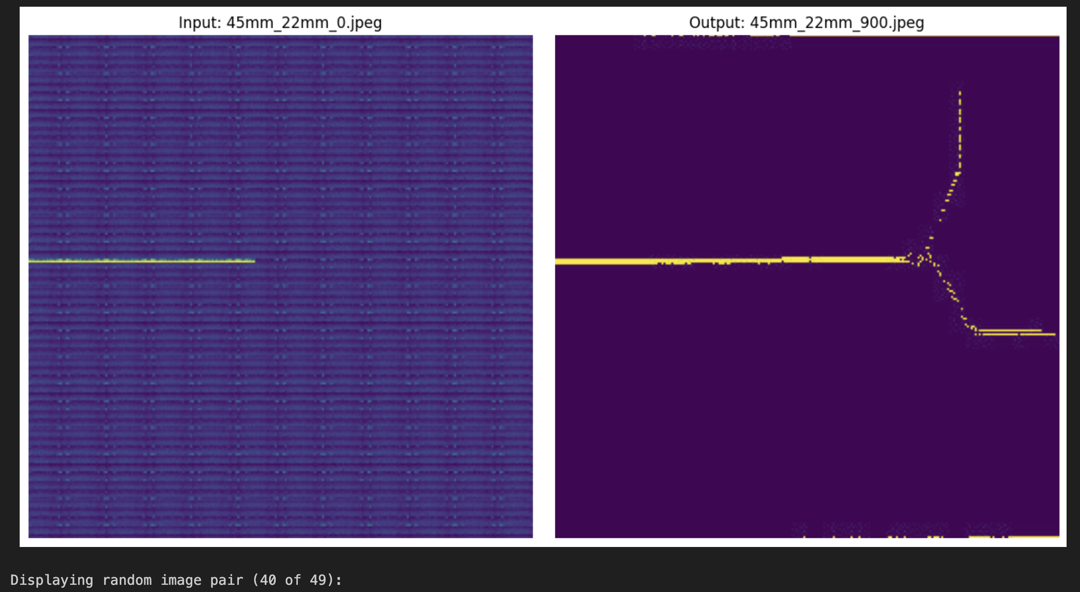

Slide 5
Our Approach
We have assumed that the cracking has happened over 50 time-steps (T=50)
The state of the plate at t =1 is given by the input image, and that at t=50 is given by the output image.
Generated the state (image) for t= 2,3…49 by ”Clipping” the output image (t=50) at various points to allow the ML model to infer information on what path the crack follows.
Implemented time series modelling to predict the evolution of the crack-branching. We have used an LSTM model which is an autoregressive model and makes use of past path progressions to evaluate future crack paths.

Slide 6
Data Preprocessing

Slide 7
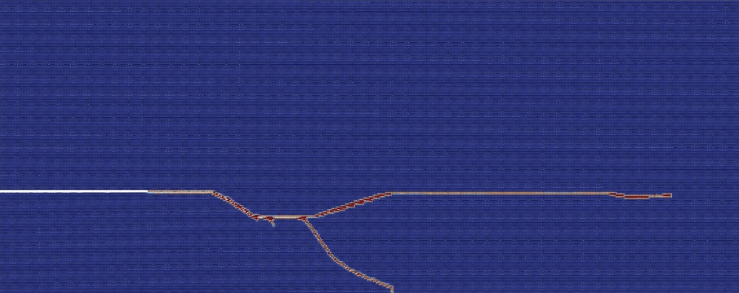
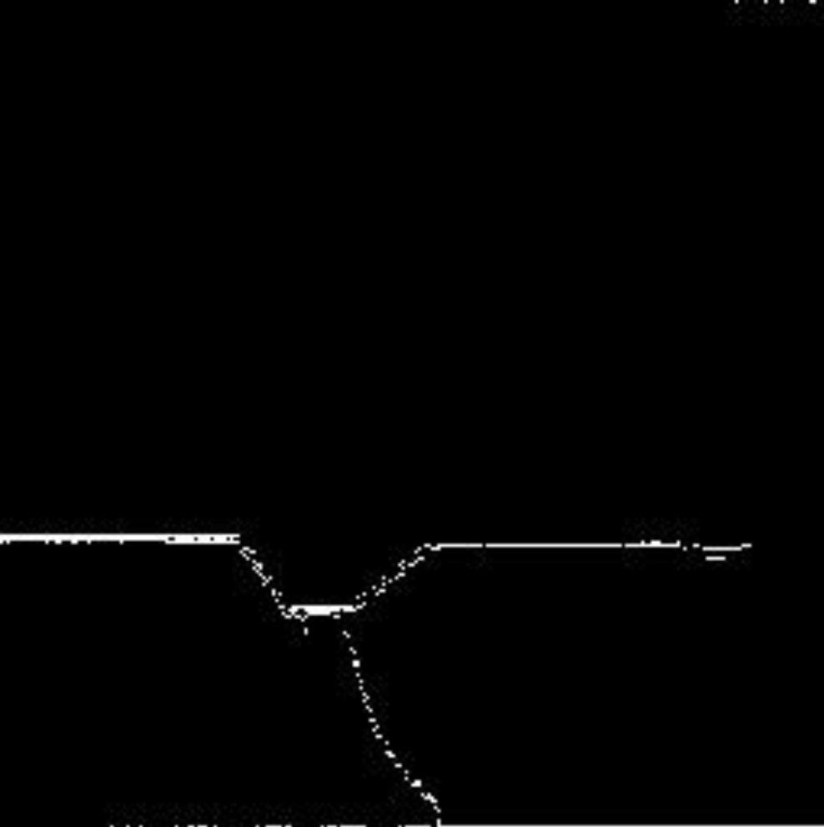
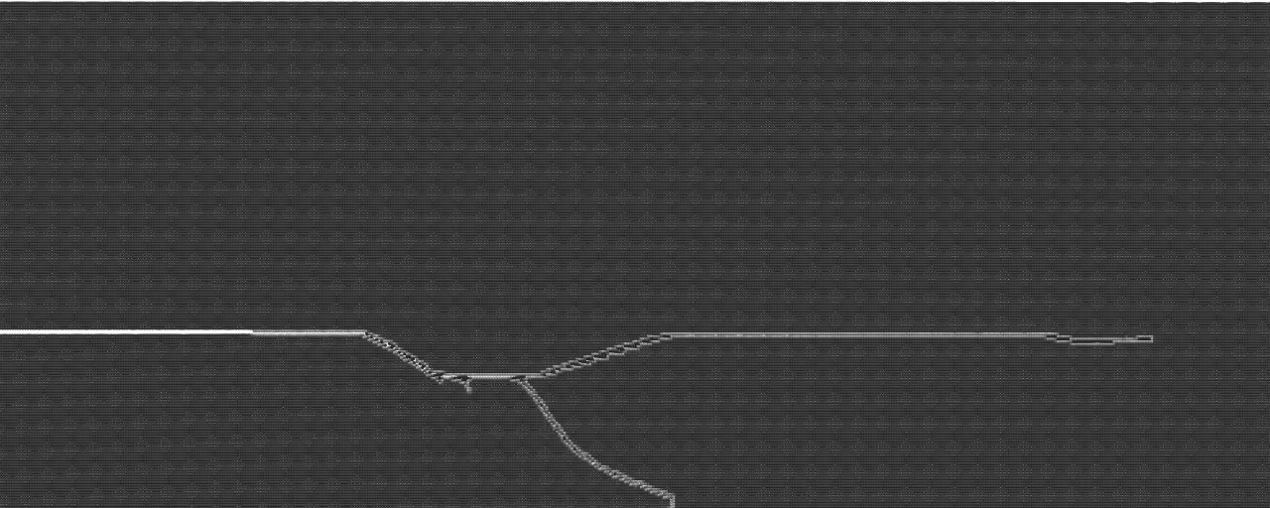
Grayscale Conversion
First converted the images to grayscale format, then set each pixel value to either 0 or 255 by setting the threshold as 128 and rescaled to 256*256 images
Original Image
Black & White (256*256)
Grayscale Image

Slide 8
Clipping
Objective: generate spatially clipped versions of crack path images for progressive prediction of final crack growth using autoregressive models.
Considered 50 points (equally spaced) starting from the end of the notch till the end of the image.
For the image at the i’th time step we have set all the pixel values to the right of the i’th point as 0 (effectively blacked out).
A sample of the progression obtained by clipping is given on the next slide.

Slide 9
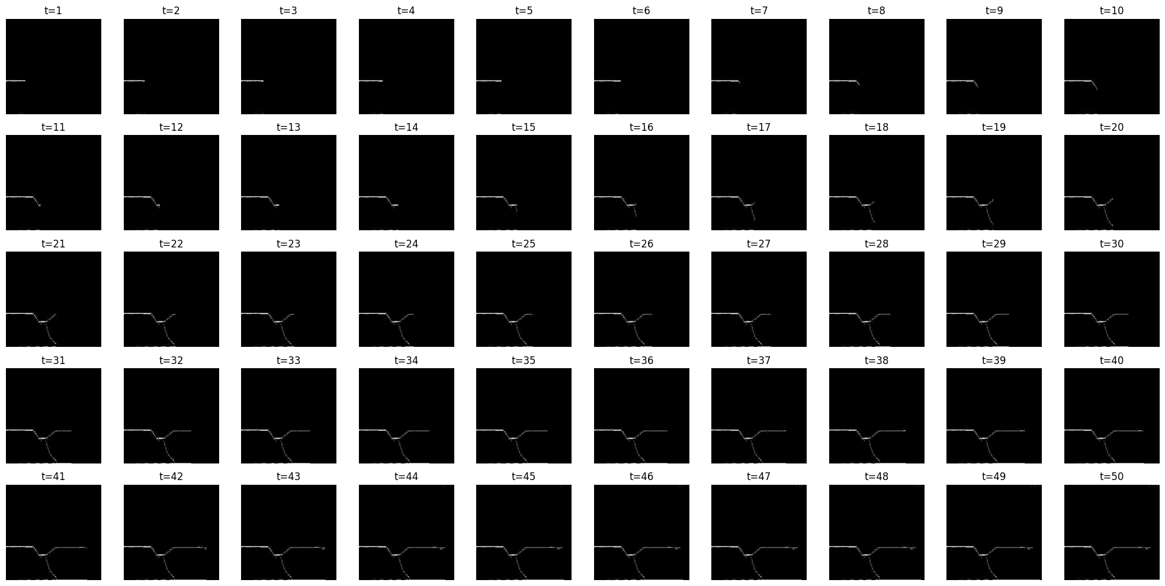

Slide 10
Model

Slide 11
Model Architecture
A recurrent neural net- work (RNN) architecture, specifically Long Short-Term Memory (LSTM), which is well-suited for modelling temporal dependencies in sequential data was used.
The input to the model consists of a sequence of grayscale image frames, each of size 256 × 256, flattened into 1D vectors of size 65,536.
This architecture allows the model to receive an image at each time step and predict the next frame in the sequence. During inference, the model operates in an auto-regressive fashion, recursively feeding its own outputs as inputs for future steps.

Slide 12
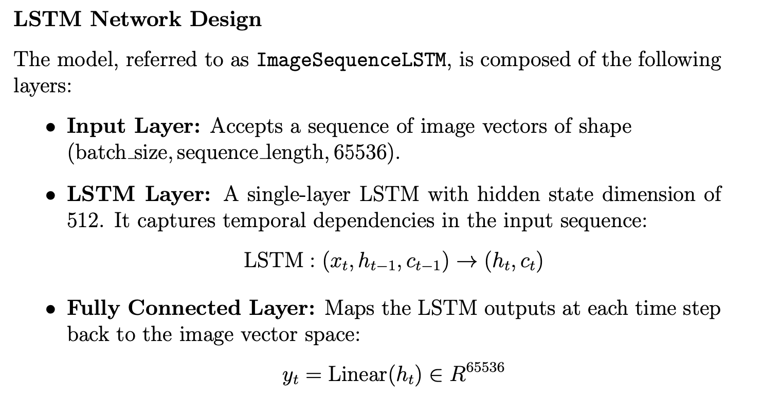

Slide 13
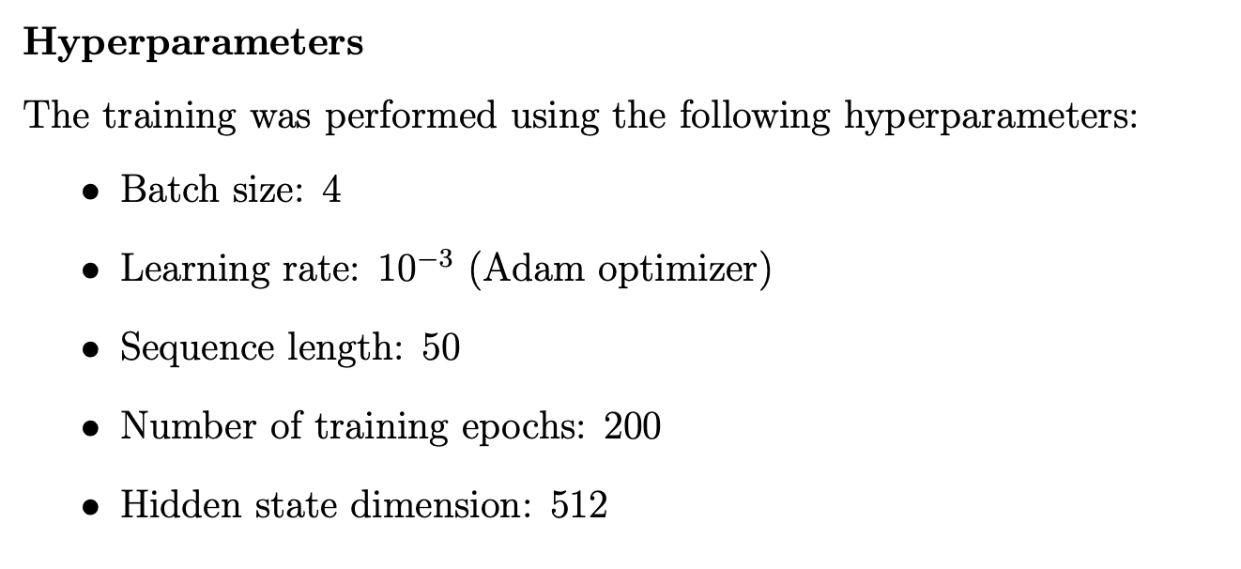
Training Procedure
The model was trained using sequences of 49 consecutive image pairs from each training sample. Each input sequence consisted of 49 frames from t = 1 to t = 49, and the corresponding target sequence consisted of the next frames from t = 2 to t = 50.

Slide 14
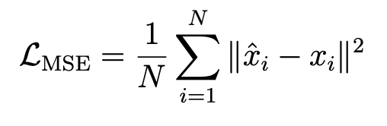
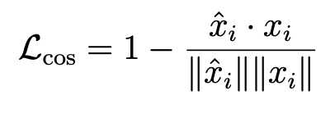
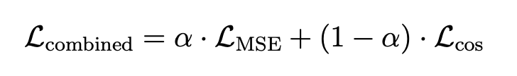
Loss Function
After exploring various loss functions, we observed best performance on a loss that combines the Cosine Similarity Loss and Mean Squared Error.
MSE penalizes the pixel-wise difference between predicted and ground truth images.
Cosine Similarity emphasizes directional alignment in the high-dimensional image space rather than pixel-wise accuracy, which may lead to better preservation of structure.
This combined loss provides a balance between preserving fine pixel-level details and overall structural consistency, resulting in smoother and more coherent long-term predictions.

Slide 15
Predictions

Slide 16
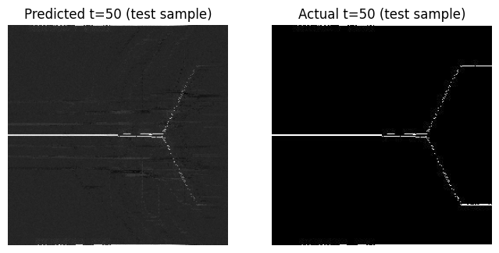
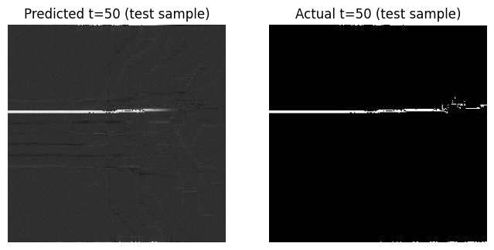
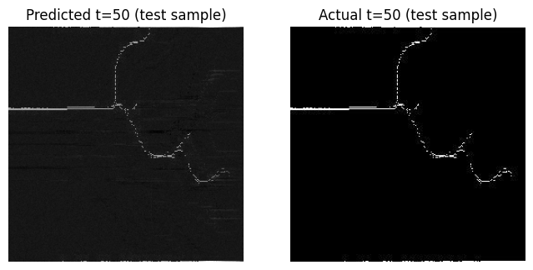
Predictions on Testing data

Slide 17
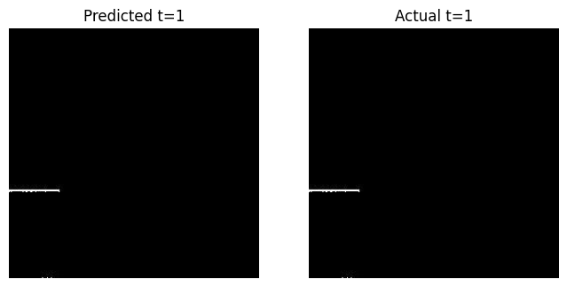
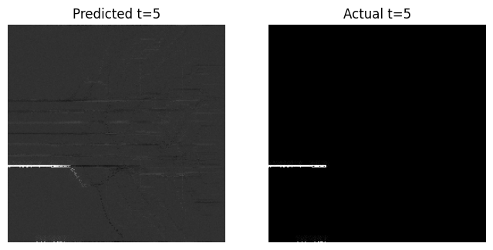
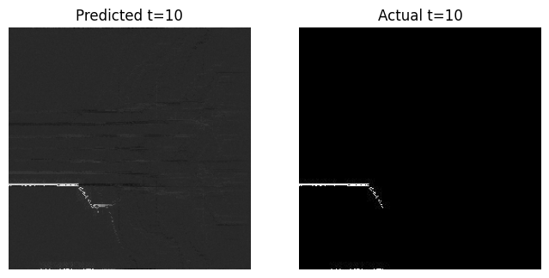
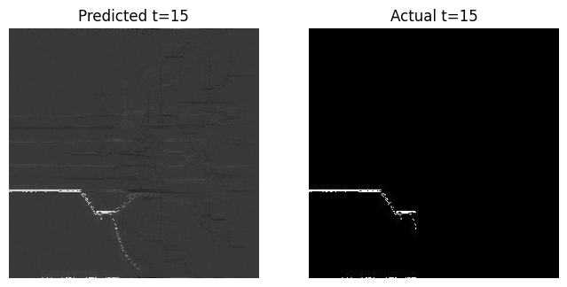
Progressive Predictions on Sample data

Slide 18
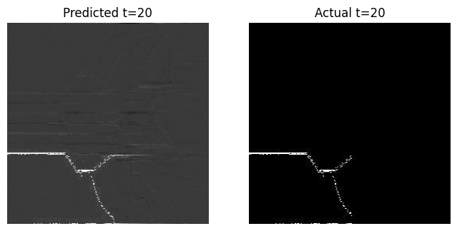
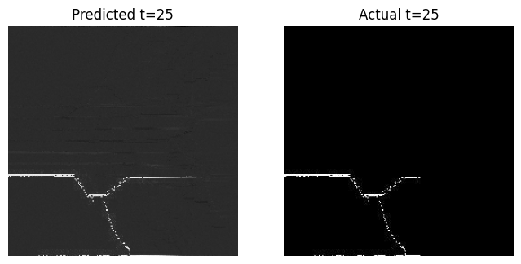
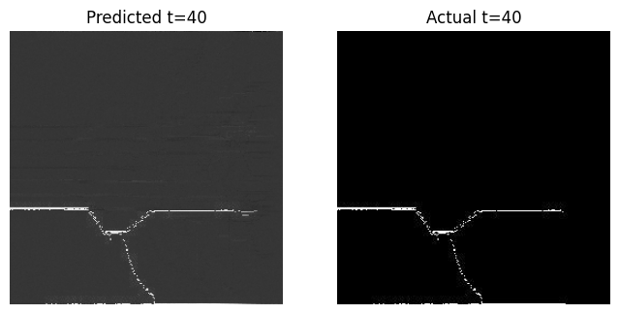
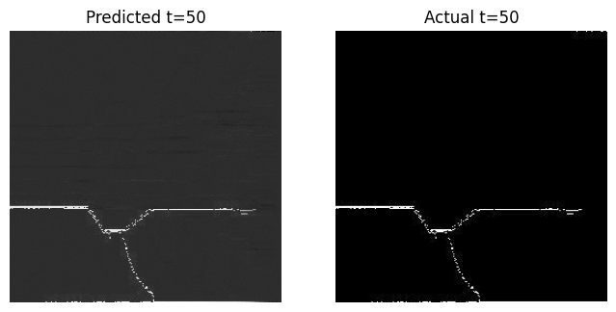

Slide 19
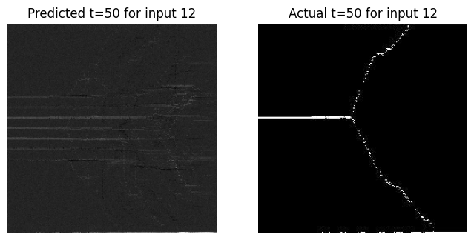
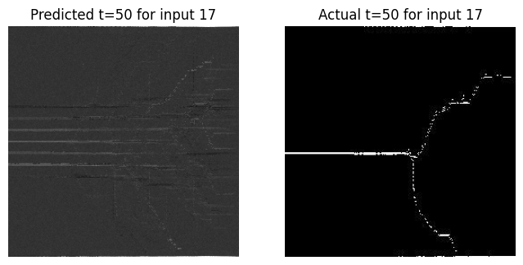
Faulty Predictions
Some predictions were still poor and highlight the fact that the model still needs improvement.
With higher compute availability, we can train an LSTM with more parameters.
We could try out more sophisticated models like transformers or simply feed more datapoints to our model.

Slide 20
Analysis & Discussion
Early stages (timesteps): Predictions closely match experimental crack growth near notch tip.
Mid Stages: Major crack paths and branching are captured despite some deviations.
Final Stage: Differences appear in secondary branches due to material and load sensitivities.
Error Propagation: Small early errors amplify over time, affecting later crack path accuracy.

Slide 21
Potential Improvements
Add a physics-based loss in the model to improve accuracy.
Loading condition variations: Extending the model to handle different loading conditions beyond simple tensile loading, such as shear, bending, or dynamic loading.
Material parameters as input: Allowing the model to accept material parameters as additional inputs, enabling generalization to different materials beyond glass.

